Slide 1
Handling Exceptions in Servlets

Slide 2
web.xml Configuration

Slide 3
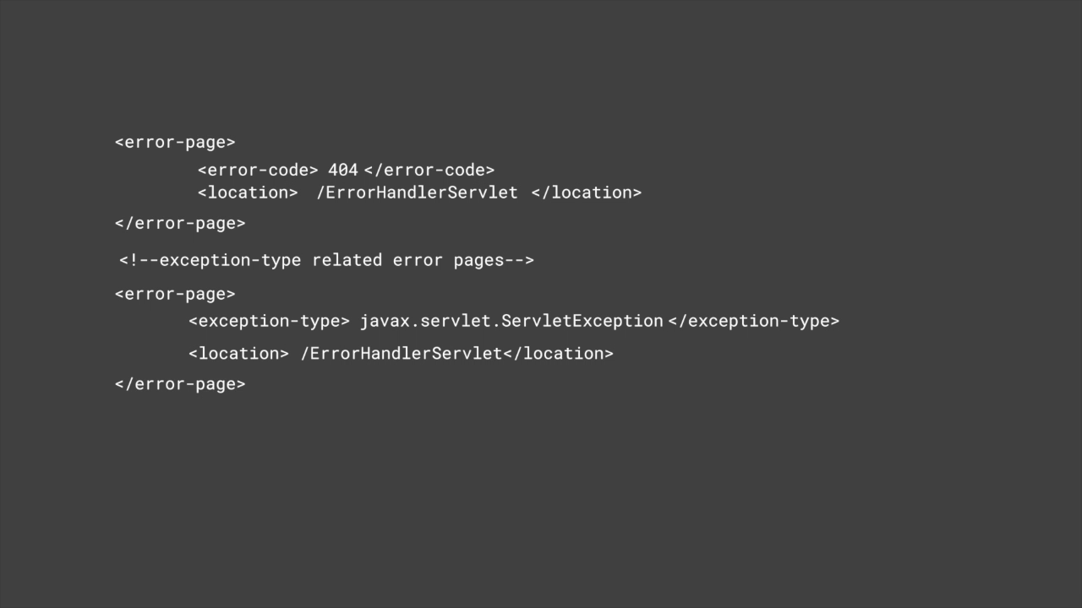

Slide 4
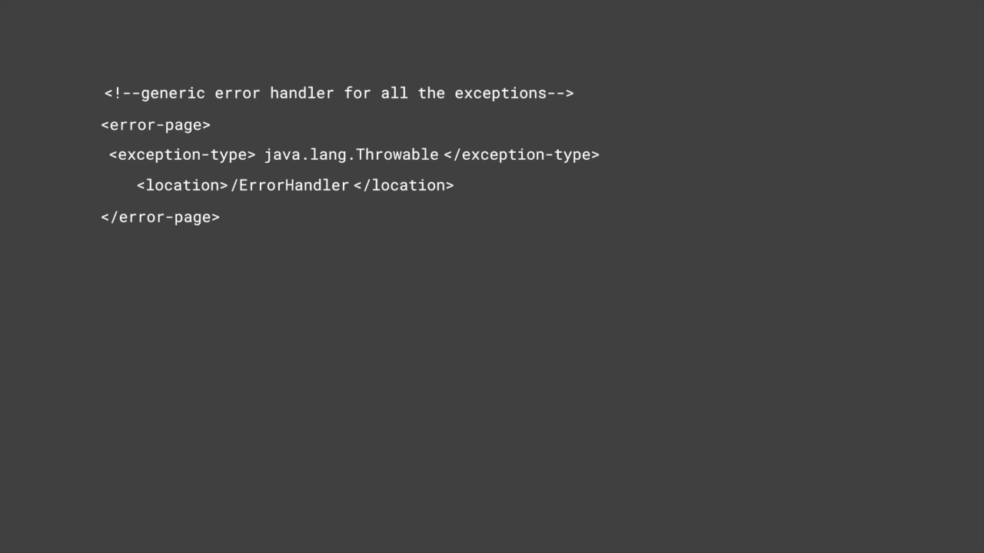

Slide 5
Points to Remember
Servlet which handles the exceptions will be defined in the same usual way as any other Servlet
A single Servlet error handler page can be used to handle any no.of error-code or exception-types

Slide 6
Request Attributes-Exceptions
Java.servlet.error.status_code Javax.servlet.error.exception_type Javax.servlet.error.message Javax.servlet.error.request_uri Javax.servlet.error.exception Javax.servlet.error.servlet_name

Slide 7

Error Handler Servlet
Assisted Practice

Slide 8

How to handle Exceptions web.xml configuration Generating ErrorHandler Servlet

